Slide 1



Instrument Independent Reduction and Analysis
at ISIS and SNS
Nick Draper
  Teswww.mantidproject.org

Slide 2
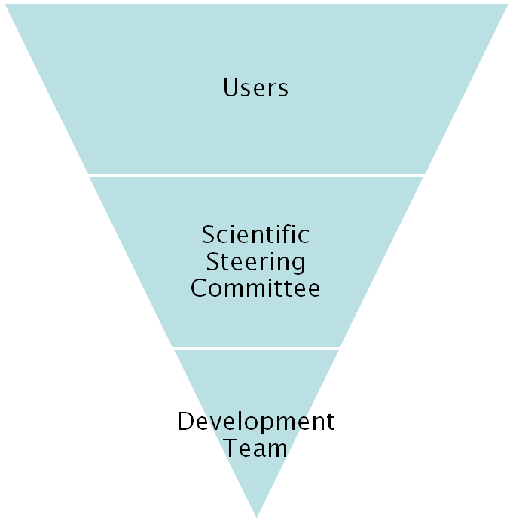
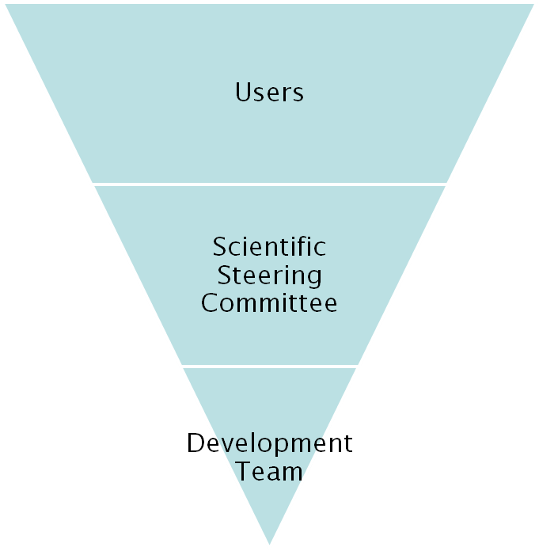
Project Organisation
ISIS
SNS/HIFR
27 beamlines, 1600 users
26 beamlines, 850 unique users
9 Key scientists
4 Key scientists
PM &
16 Developers
Project Management Board

Slide 3
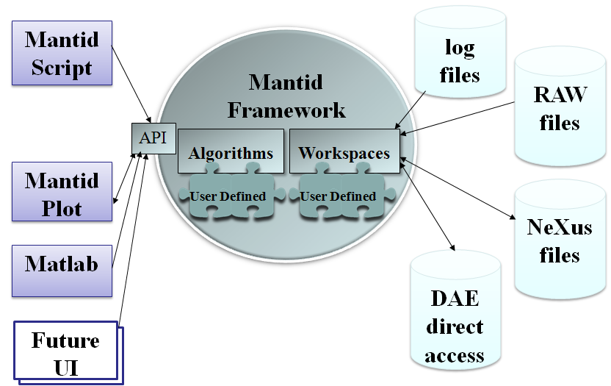

How we do it Technically
Organisation
  Open source
  Continuous integration
  Automated build, test & deploy
  Distributed team
C++ Framework
  Win, Linux, Mac
  Memory Management
  Performance optimisation
    OpenMP
  Common Interfaces
  Plug in Mechanism
ICAT
Qt GUI
  Extended from QtiPlot
Python Scripting
  Using Boost Python
  Powerful and extensive coverage
  Integration with NumPy

Slide 4
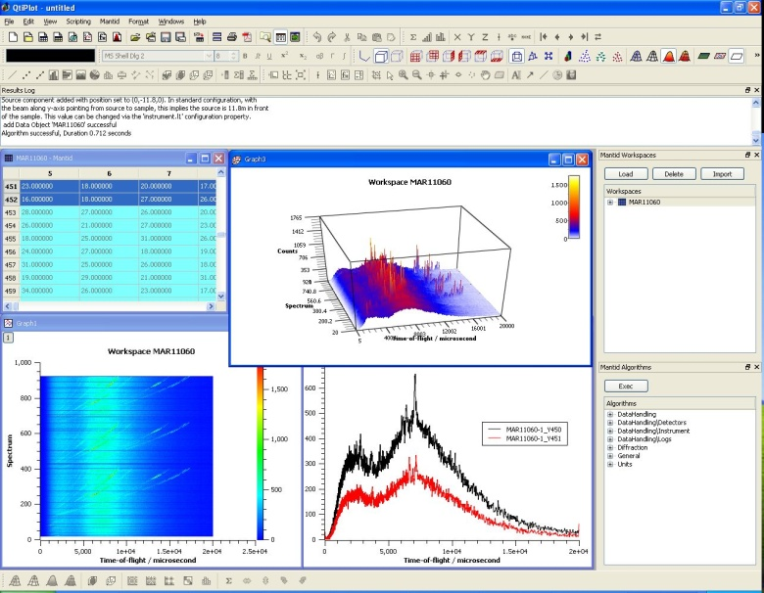
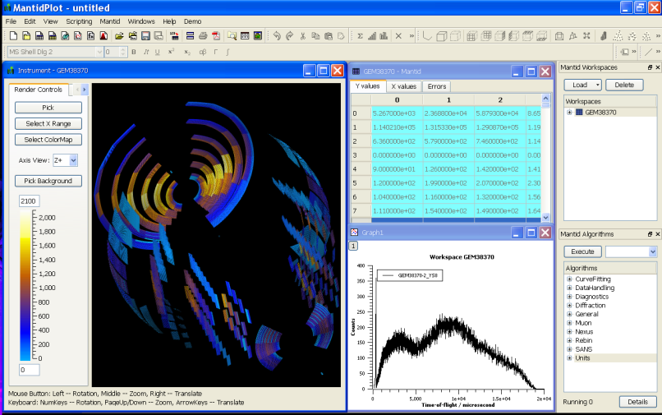
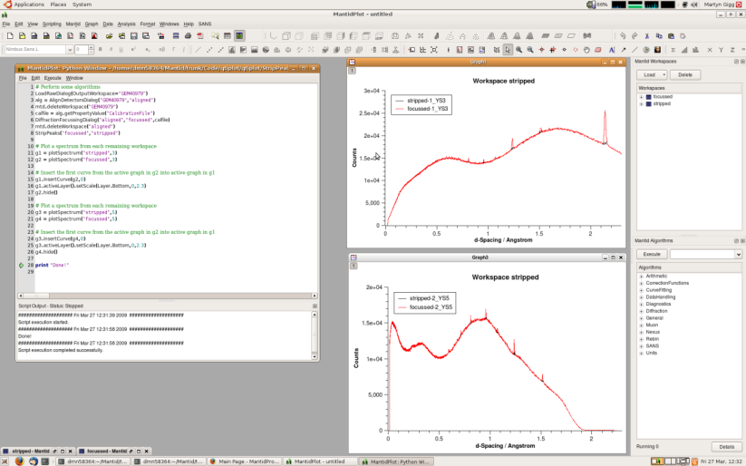
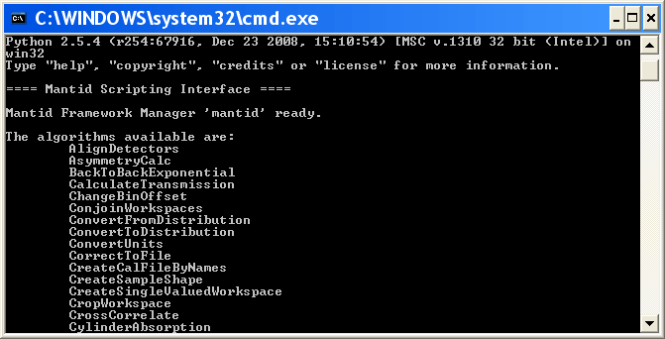
User interfaces
MantidPlot
  1, 2 and 3D plotting
  Interactive Instrument view
  Ad hoc analysis
  Specific User interfaces
  Integrated scripting
  Extendable with plugins
MantidScript
  Pure command
  line support

Slide 5
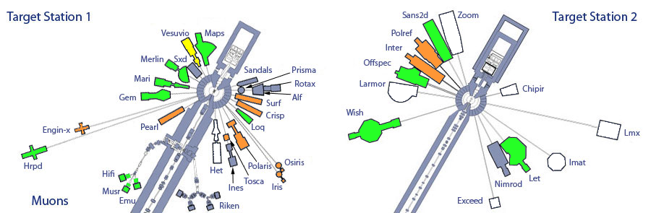
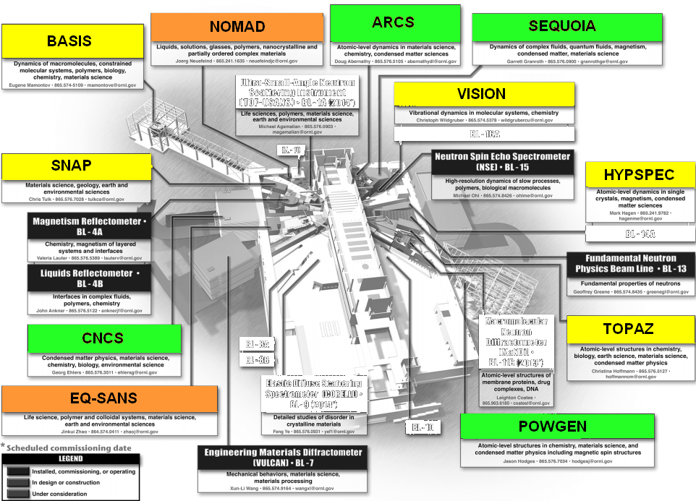
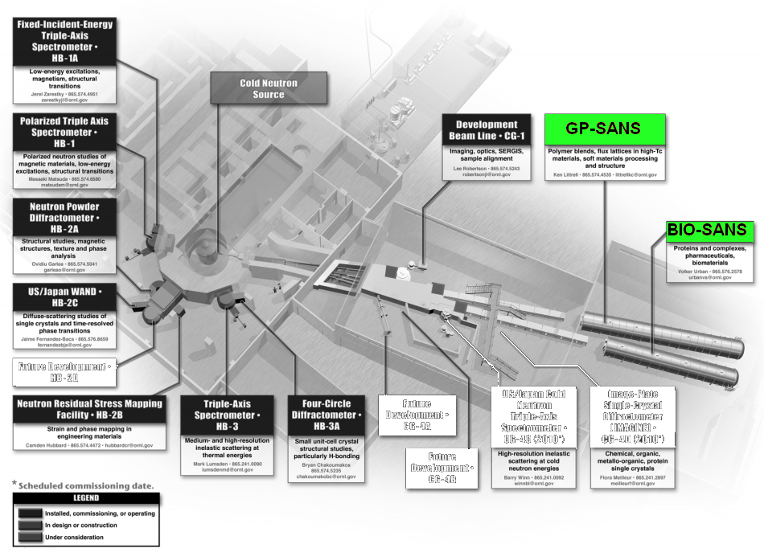
Rollout
ISIS
In
Use
Under Evaluation
Active Development
SNS
HFIR

Slide 6
Other possible collaborations
ILL
  Pilot starting to evaluate and improve support for Triple Axis apectrometers
Julich & Helmholtz association
  Considering piloting Mantid and possible becoming a full partner
ESS
  Planning to use Mantid for data reduction
  Initial steps will increase Mantid – McStas integration

Slide 7


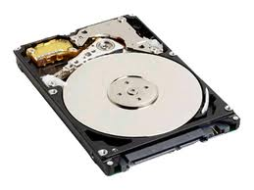
VATES - Advanced visualisation & analysis
Problem
  Large 100GB datasets
  4+ dimensions
    Q(x,y,z), ω, temp, field, etc.
Solution
  Distributed Parallel visualization
    Paraview
  On the fly parallel data rebinning
DataFile
Your Laptop
Analysis+Visualization
Servers

Slide 8
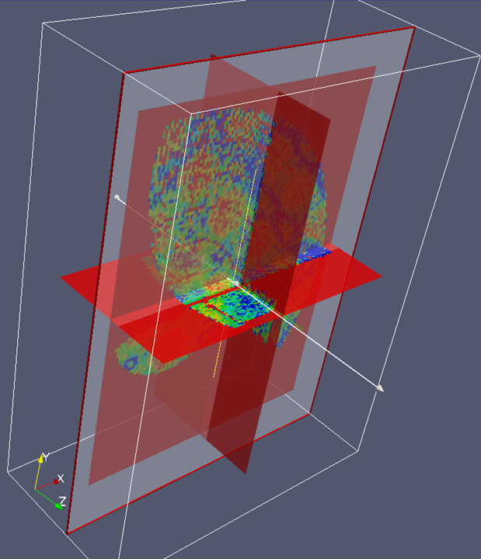
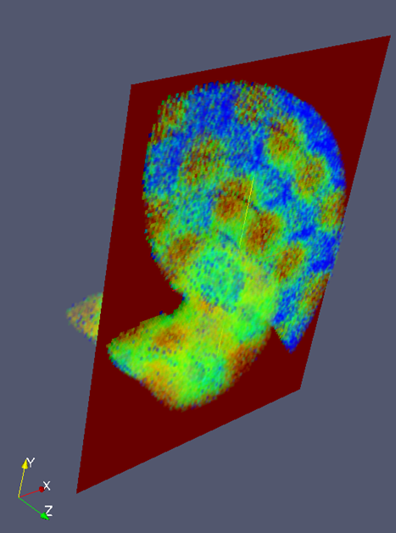

Multidimensional data visualisation

Slide 9

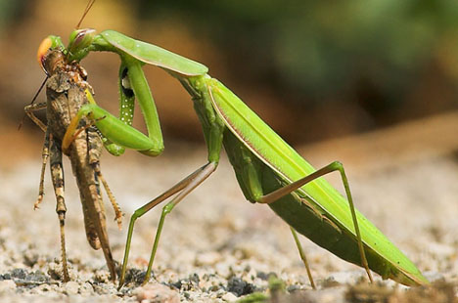
Mantid & Danse

Slide 10


Mantid – Danse Scope
Analysis
Reduction
Capture/ Instrument Control
SANS
Reflectometry
Inelastic

Slide 11
Integration Possibilities
Control Scope
  Maintenance
    We cannot do everything
  Installer/ pre requisite bloat
    Harder to install for users and maintain for us
    Places restrictions on DANSE
Provide a good user experience
  Usage
  Installation
Maximise reuse – effort
Start Simple!

Slide 12
Mantid SANS Requirements
Provide a comprehensive SANS model fitting solution
Provide an extensible library of models
  Some cab be integrated from FISH
Support complex constraint functions

Slide 13
DANSE SANS software
SANS Models
  Library of 50+ models
  Originally from NIST
  Thoroughly tested
  Accessible via C++ and Python
SANSView
  Fitting package in 1D and 2D
  Constrained fitting
  “slicing tools”
  P(r) inversion, SLD calculation

Slide 14
Mantid DANSE SANS plan
Integrate with SANSView
  File Transfer for SANSView
    via CanSAS1S and Nexus formats
  Reading NIST raw data into Mantid
    Improve file integration
    Speed up testing
  Launch SANSView from Mantid
    Identifying file to load
    SANSView must be easy to install on Win, Mac and Linux
  Integrating SANS models into Mantid
    From both DANSE and FISH
    Using a thin translation layer if possible

Slide 15
Mantid DANSE SANS plan
  Integrating SANS models into Mantid
    From both DANSE and FISH
    Using a thin translation layer if possible
  Add a P(r) inversion algorithm to Mantid
    Using the underlying DANSE package
  Integrating the SANSView Calculators & Data Processors into Mantid
    Scattering Length Density
    Sector averaging
    Box summing
    All use PeriodicTable (already in use in Mantid)

Slide 16
Reflectometry
DANSE SANS software
  Reflectometry Models
  GARefl
    Simultaneous model fitting for multiple data sets
Mantid DANSE SANS plan
  Provide an easy to use user interface
    Easy to install
  Launch from within Mantid

Slide 17
Inelastic
VNF
  Produce Event based Nexus file output
    Can be read into Mantid
Mystic, Pathos
    To be considered for VATES distributed computing
    Need to be careful about too many C++ - Python switches
Third Party Bindings
  Gulp, VASP, Quantum Expresso
    Could be of direct use in VATES

Slide 18
Diffraction
PDFFit / PDFGUI
    Integrate at a file level
    Initially via PDFgetN, later direct
SrRietveld
    Batch processing of reduced data
      Already possible in Fullprof directly
    More interesting:
      Extract out data from the refinement of multiple datasets
      Plotting using run meta data
        Trend plotting and fitting
        Display of 2D and 3D engineering stress maps

